Slide 1
Simple Data Types
COS 1020 C++ Programming
AUBG COS Department
Based on chapter 7 – problem solving, abstraction and design using C++, Friedman & Koffman

Slide 2
Lecture Contents
7.1 Constants Revisited
7.2 Character Data and Functions
7.3 Enumeration Types

Slide 3
Constants Revisited - #define
Constants are named identifiers that cannot be changed in the program:
  const float PI = 3.14159;
Another way to define constants is by using the #define directive:
  #define identifier replacement-text
Any occurrence of identifier (not enclosed in quotes and not part of another name) will be replaced by the given replacement-text
  #define PI 3.14159

Slide 4
Character Data and Functions
The char type is used to contain individual characters
Character literals consist of a character surrounded by single quotes
Examples:
const char STAR = '*';
const char ENDLINE = '\n';
char nextLetter;
nextLetter = 'A';

Slide 5
Character Representation
Each character has a unique 1-byte numeric code
Those codes are referred to as ASCII codes and are the adopted standard for representing text in computers
Printable charters from 32 till 126.
We can convert between char and int:
cout << int('A') << endl; // 65 (90)
cout << int('0') << endl; // 48 (57)
cout << char(97) << endl; // a (122)

Slide 6
Some Useful Character Functions
char tolower(char);
char toupper(char);
bool isalpha(char);
bool isdigit(char);
bool isalnum(char);
bool islower(char);
bool isspace(char);
bool isupper(char);

Slide 7
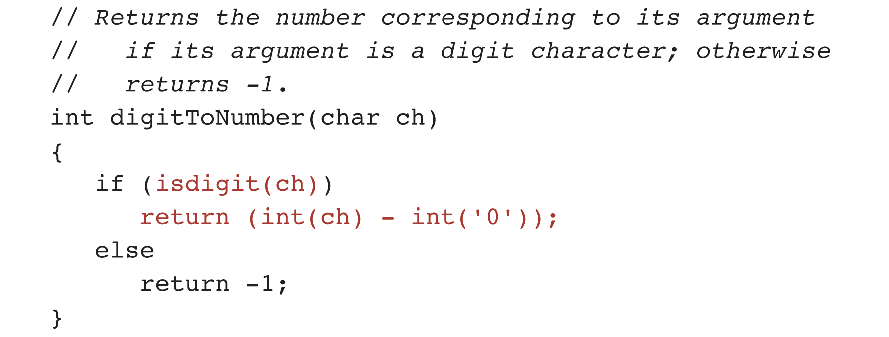
Example: Function digitToNumber

Slide 8
Enumeration Types
An enumeration type is a user-defined data type that has a list of allowed values:
  enum day { sunday, monday, tuesday, wednesday,
  thursday, friday, saturday };
The above definition associates the identifier sunday with the integer value 0, monday with 1 and so on
Variables declared with an enum type can be assigned values that are part of the enumerator list of that enum declaration:
day today = friday;

Slide 9
Enumeration Types (continued)
  enum month { jan = 1, feb, mar, apr, may, june,
  jul, aug, sep, oct, nov, dec};
  enum specialChar { backspace = ’\b’,
  newline = ‘\n’,
  tab = ‘\t’};

Slide 10
Enumeration Type Declarations
General form:
  enum enumeration-type {enumerator-list};
Example:
enum classId { freshman, sophomore, junior, senior };
classId newClass;
if (newClass == freshman)
// do something
else if (newClass == sophomore)
// ...

Slide 11
Comparisons Involving Enumeration Types
The order relationship among the enumerators of an enum type is determined by the order of enumerators in the list
sunday < monday
wednesday != tuesday
wednesday == wednesday
thursday > monday
Cannot mix enumeration types:
entertainment != monday // WRONG

Slide 12
Reading and Writing Enumeration Type Values
Enum types are defined by the programmer and their values are not known in advance
The C++ input/output systems cannot read or write these values directly
We can implement functions to do that:
enum color { red, green, blue, yellow };
color eyeColor = blue;
writeColor(eyeColor); // function call

Slide 13
Example: Function to display a value of type color
void writeColor(color thisColor) { // IN: color to display as a string
// Display color value as a string.
switch (thisColor) {
case red:
cout << "red"; break;
case green:
cout << "green"; break;
case blue:
cout << "blue"; break;
case yellow:
cout << "yellow"; break;
default:
cout << "*** ERROR: Invalid color value." << endl;
}
}

Slide 14
Example: Function to display a value of type color (continued)
int main()
{
color test = red;
writeColor((color)0);
cout << endl;
writeColor(test);
cout << endl;
writeColor((color)9);
return 0;
}

Slide 15
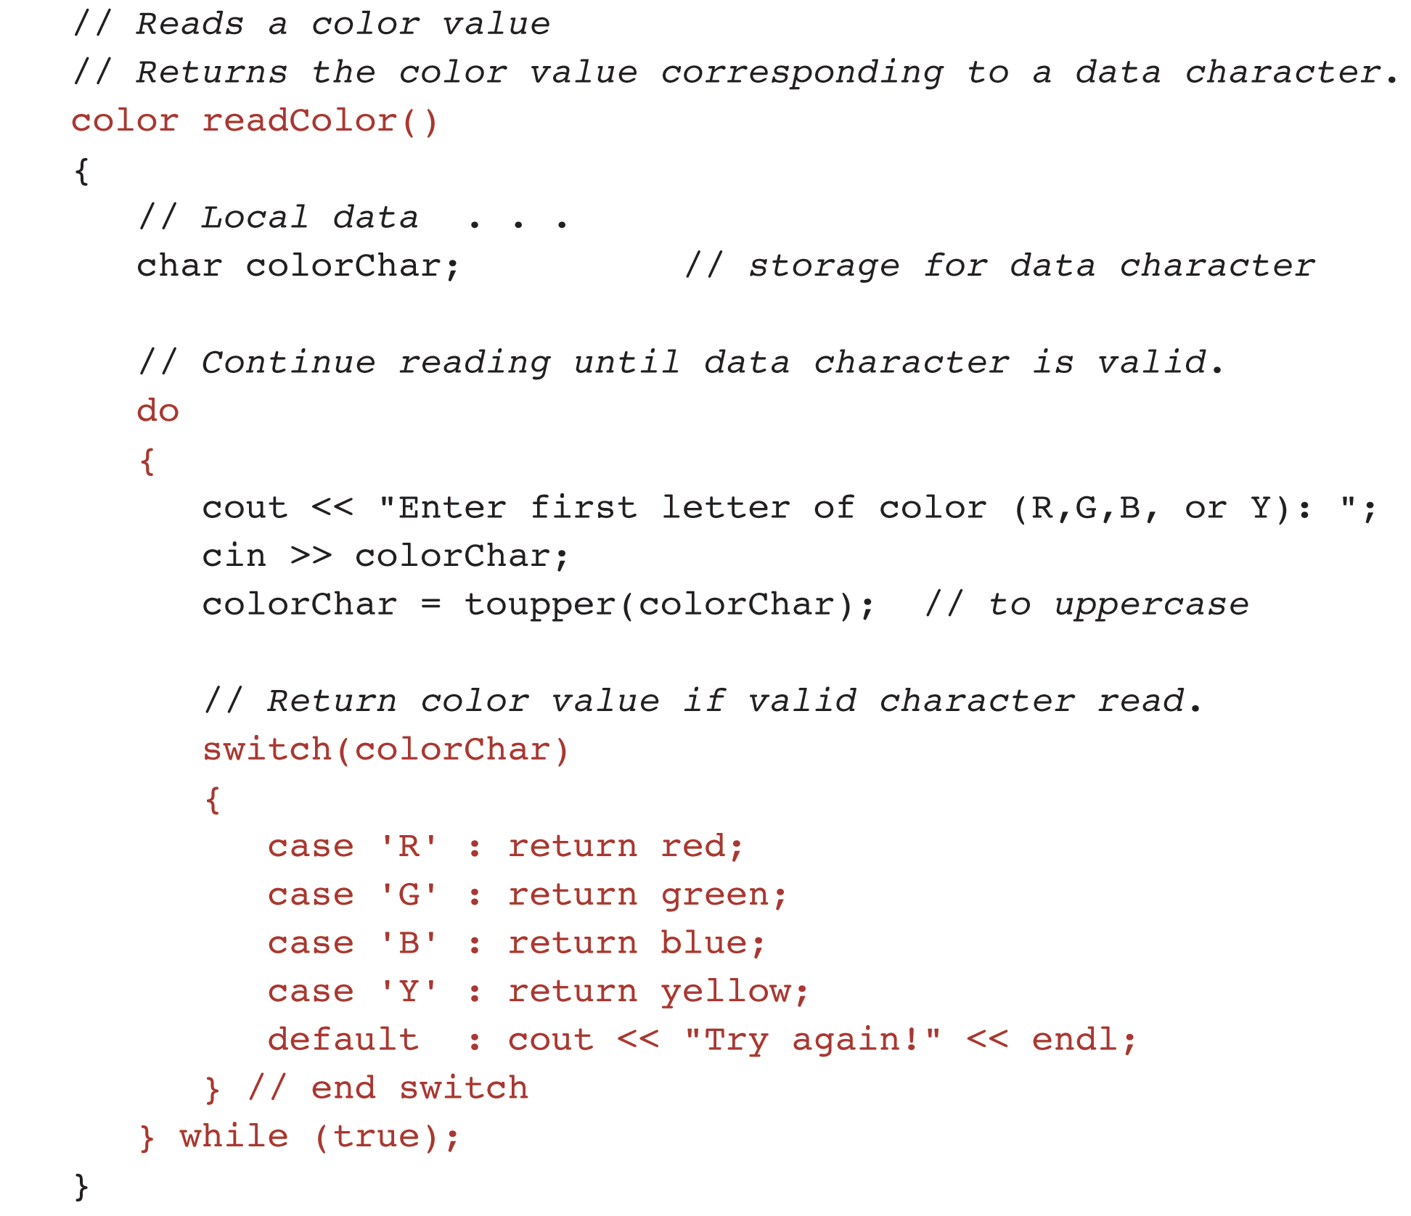
Example: Function to read a value of type color

Slide 16
Questions?
Q & A

